Slide 1
Responsive Web Design
Thi Tran

Slide 2
What is Responsive Web Design?

Slide 3
Some explanations
Google: A multitude of different screen sizes exist across phones, "phablets," tablets, desktops, game consoles, TVs, and even wearables. Screen sizes are always changing, so it's important that your site can adapt to any screen size, today or in the future
w3school: Responsive Web Design is about using HTML and CSS to automatically resize, hide, shrink, or enlarge, a website, to make it look good on all devices (desktops, tablets, and phones)

Slide 4
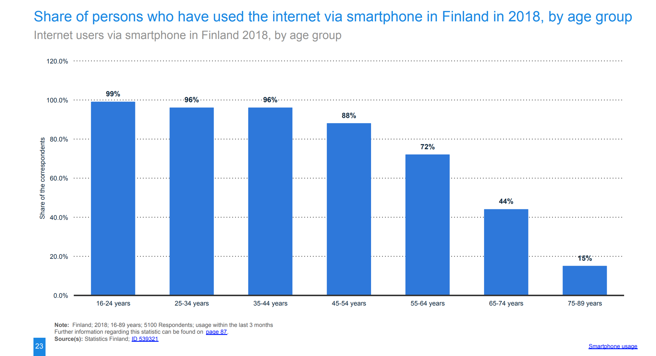
Why responsive?

Slide 5
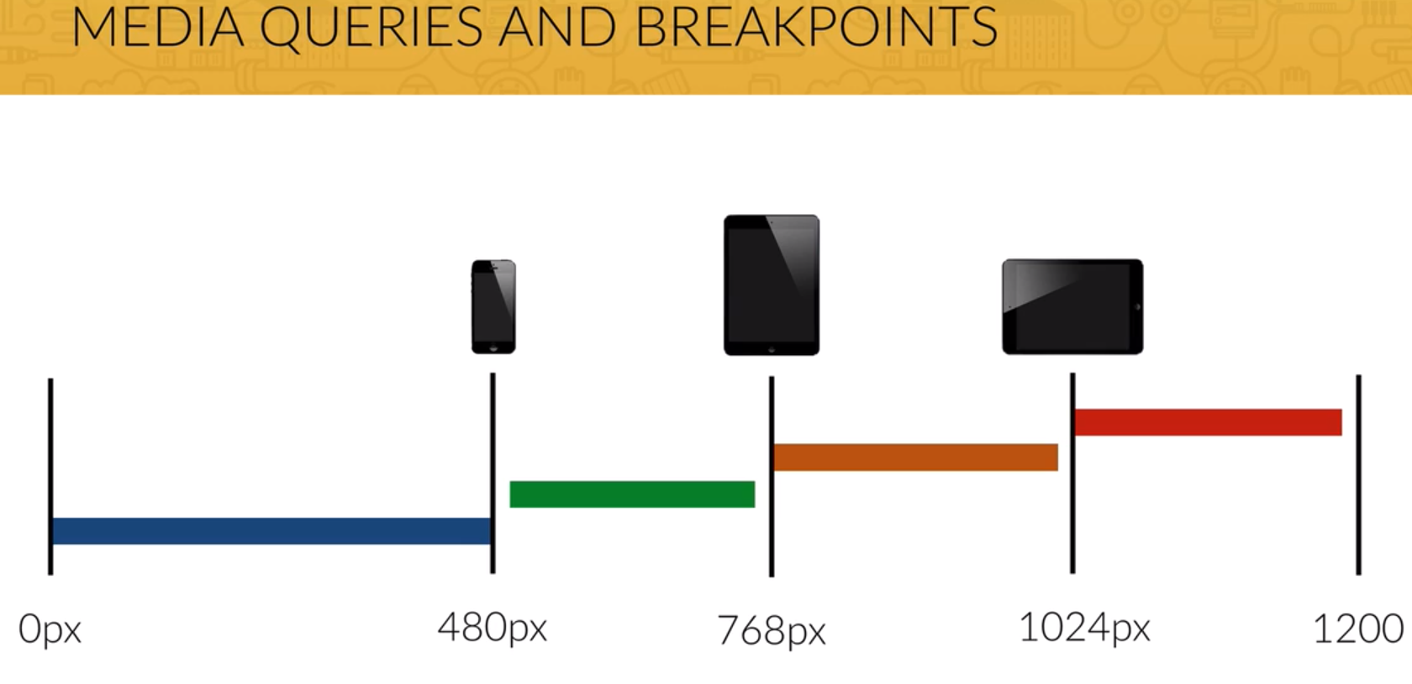
How responsive?
Source: Jonas Schmedtmann

Slide 6
Steps
Include meta tag
<meta name="viewport" content="width=device-width, initial-scale=1.0">
Create queries file
Start to code

Slide 7


Now, let’s code!
Item in row
Creative way of responsive

Slide 8
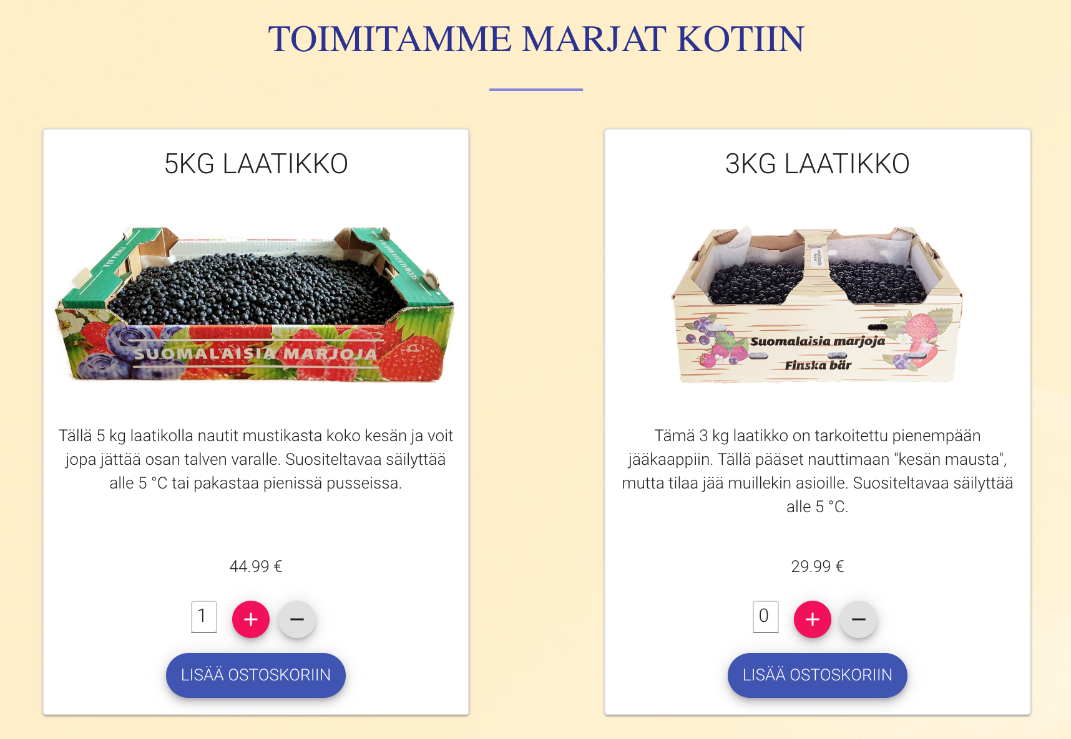
Homework
Customize Products section

Slide 9
Some other sources
https://www.w3schools.com/html/html_responsive.asp
https://teamtreehouse.com/library/your-responsive-toolbox
http://www.instantshift.com/2014/02/17/responsive-web-design-toolbox/
https://www.udemy.com/design-and-develop-a-killer-website-with-html5-and-css3/learn/lecture/2619816#overview

